Slide 1
Unit Root Tests
Examining Time Series for Non-Constant Trend
”

Slide 2
Let’s look at data from CO₂ from a furnace

Slide 3
Eyeball Test for Non-Constant Mean
Let’s draw a line through the center of the data and see if the line is flat (constant mean = no trend) or if it trends up or down (non-constant mean = trend).
Notice that the line is not flat – there is a non-constant mean or trend!

Slide 4
ACF Graph Inspection for Non-Constant Mean
Let’s look at the acf graph to see if there is evidence of a “ski slope”. If so, then there is evidence of a non-constant mean or trend.
Notice the “ski slope” of the bars – indicating non-constant mean or trend

Slide 5
KPSS Test
The KPSS test looks for a unit root. Here are the null and alternative hypotheses:
KPSS
Hnull: no evidence of non-constant mean
Halt: evidence of non-constant mean
KPSS test for co2
T = 296
Lag truncation parameter = 5
Test statistic = 1.05207
10% 5% 1%
Critical values: 0.348 0.462 0.741
P-value < .01

Slide 6
KPSS Test
KPSS
Hnull: no evidence of non-constant mean
Halt: evidence of non-constant mean
KPSS test for co2
T = 296
Lag truncation parameter = 5
Test statistic = 1.05207
10% 5% 1%
Critical values: 0.348 0.462 0.741
P-value < .01
Because p < .05, reject Hnull and accept Halt. There is evidence of a non-constant mean.

Slide 7
Augemented Dickey Fuller (ADF) Test
The ADF test looks for a unit root. Here are the null and alternative hypotheses:
ADF
Hnull: evidence of non-constant mean
Halt: no evidence of non-constant mean
Augmented Dickey-Fuller test for co2
testing down from 15 lags, criterion AIC
sample size 288
unit-root null hypothesis: a = 1
test with constant
including 7 lags of (1-L)co2
model: (1-L)y = b0 + (a-1)*y(-1) + ... + e
estimated value of (a - 1): -0.0207916
test statistic: tau_c(1) = -2.7566
asymptotic p-value 0.06469
1st-order autocorrelation coeff. for e: 0.004
lagged differences: F(7, 279) = 164.100 [0.0000]
with constant and trend
including 4 lags of (1-L)co2
model: (1-L)y = b0 + b1*t + (a-1)*y(-1) + ... + e
estimated value of (a - 1): -0.0294351
test statistic: tau_ct(1) = -3.74594
asymptotic p-value 0.01941
1st-order autocorrelation coeff. for e: -0.007
lagged differences: F(4, 284) = 287.904 [0.0000]

Slide 8
Augmented Dickey Fuller Test (ADF)
ADF
Hnull: evidence of non-constant mean
Halt: no evidence of non-constant mean
Augmented Dickey-Fuller test for co2
testing down from 15 lags, criterion AIC
sample size 288
unit-root null hypothesis: a = 1
test with constant
including 7 lags of (1-L)co2
model: (1-L)y = b0 + (a-1)*y(-1) + ... + e
estimated value of (a - 1): -0.0207916
test statistic: tau_c(1) = -2.7566
asymptotic p-value 0.06469
1st-order autocorrelation coeff. for e: 0.004
lagged differences: F(7, 279) = 164.100 [0.0000]
with constant and trend
including 4 lags of (1-L)co2
model: (1-L)y = b0 + b1*t + (a-1)*y(-1) + ... + e
estimated value of (a - 1): -0.0294351
test statistic: tau_ct(1) = -3.74594
asymptotic p-value 0.01941
1st-order autocorrelation coeff. for e: -0.007
lagged differences: F(4, 284) = 287.904 [0.0000]
Because p > .05, cannot reject Hnull. There is evidence of a non-constant mean.

Slide 9
Let’s look at Differenced Data

Slide 10
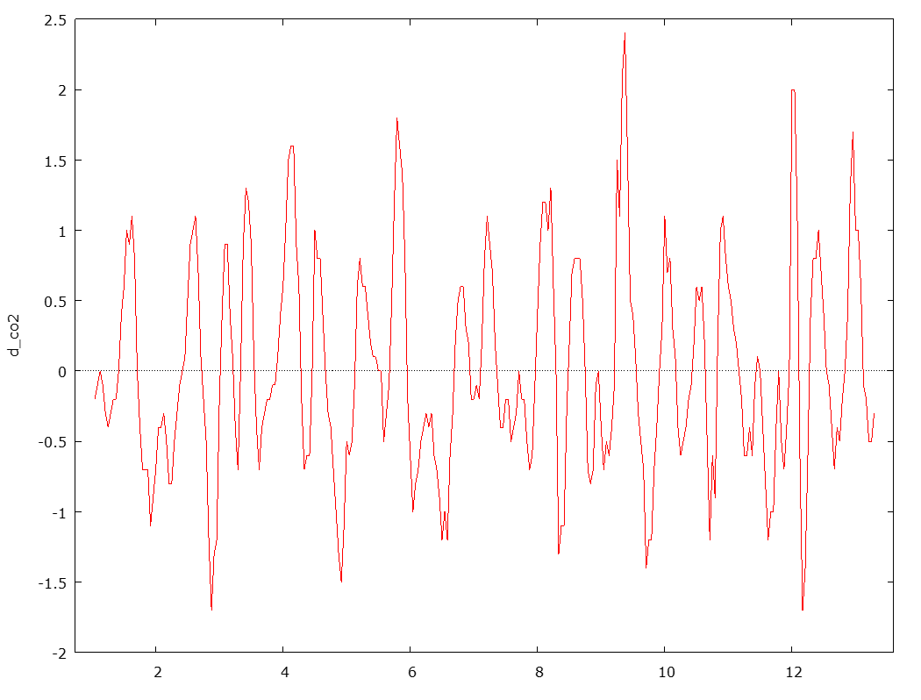
Eyeball Test on Differenced Data
Let’s draw a line through the center of the data and see if the line is flat (constant mean = no trend) or if it trends up or down (non-constant mean = trend).
Notice that the line is flat – there is a constant mean or no trend!

Slide 11
ACF Graph Inspection Differenced Data
Let’s look at the acf graph to see if there is evidence of a “ski slope”. If so, then there is evidence of a non-constant mean or trend.
Notice the “ski slope” of the bars – indicating non-constant mean or trend

Slide 12
KPSS Test for Differenced Data
The KPSS test looks for a unit root. Here are the null and alternative hypotheses:
KPSS
Hnull: no evidence of non-constant mean
Halt: evidence of non-constant mean
KPSS test for d_co2
T = 295
Lag truncation parameter = 5
Test statistic = 0.0246346
10% 5% 1%
Critical values: 0.348 0.462 0.741
P-value > .10

Slide 13
KPSS Test for Differenced Data
KPSS
Hnull: no evidence of non-constant mean
Halt: evidence of non-constant mean
KPSS test for d_co2
T = 295
Lag truncation parameter = 5
Test statistic = 0.0246346
10% 5% 1%
Critical values: 0.348 0.462 0.741
P-value > .10
Because p > .05, cannot reject Hnull. There is no evidence of a non-constant mean.

Slide 14
ADF Test for Differenced Data
The ADF test looks for a unit root. Here are the null and alternative hypotheses:
ADF
Hnull: evidence of non-constant mean
Halt: no evidence of non-constant mean
Augmented Dickey-Fuller test for d_co2
testing down from 15 lags, criterion AIC
sample size 288
unit-root null hypothesis: a = 1
test with constant
including 6 lags of (1-L)d_co2
model: (1-L)y = b0 + (a-1)*y(-1) + ... + e
estimated value of (a - 1): -0.370338
test statistic: tau_c(1) = -7.55824
asymptotic p-value 9.404e-012
1st-order autocorrelation coeff. for e: 0.001
lagged differences: F(6, 280) = 26.671 [0.0000]
with constant and trend
including 6 lags of (1-L)d_co2
model: (1-L)y = b0 + b1*t + (a-1)*y(-1) + ... + e
estimated value of (a - 1): -0.371244
test statistic: tau_ct(1) = -7.55318
asymptotic p-value 5.358e-011
1st-order autocorrelation coeff. for e: 0.001
lagged differences: F(6, 279) = 26.604 [0.0000]

Slide 15
ADF Test for Differenced Data
ADF
Hnull: evidence of non-constant mean
Halt: no evidence of non-constant mean
Augmented Dickey-Fuller test for d_co2
testing down from 15 lags, criterion AIC
sample size 288
unit-root null hypothesis: a = 1
test with constant
including 6 lags of (1-L)d_co2
model: (1-L)y = b0 + (a-1)*y(-1) + ... + e
estimated value of (a - 1): -0.370338
test statistic: tau_c(1) = -7.55824
asymptotic p-value 9.404e-012
1st-order autocorrelation coeff. for e: 0.001
lagged differences: F(6, 280) = 26.671 [0.0000]
with constant and trend
including 6 lags of (1-L)d_co2
model: (1-L)y = b0 + b1*t + (a-1)*y(-1) + ... + e
estimated value of (a - 1): -0.371244
test statistic: tau_ct(1) = -7.55318
asymptotic p-value 5.358e-011
1st-order autocorrelation coeff. for e: 0.001
lagged differences: F(6, 279) = 26.604 [0.0000]
Because p < .05, can reject Hnull. There is no evidence of a non-constant mean.

